Slide 1
Unit V Indexing and Hashing
Symbiosis Institute of Technology,
Nagpur
Department of CSE

Slide 2
Physical and Logical Hierarchy
Indexing mechanisms used to speed up access to desired data.
E.g., author catalog in library
Search Key - attribute to set of attributes used to look up records in a file.
An index file consists of records (called index entries) of the form
Index files are typically much smaller than the original file
Two basic kinds of indices:
Ordered indices: search keys are stored in sorted order
Hash indices: search keys are distributed uniformly across “buckets” using a “hash function”.
search-key
pointer

Slide 3
Index Evaluation Metrics
Access types supported efficiently. E.g.,
records with a specified value in the attribute
or records with an attribute value falling in a specified range of values (e.g. 10000 < salary < 40000)
Access time
Insertion time
Deletion time
Space overhead

Slide 4
Ordered Indices
In an ordered index, index entries are stored sorted on the search key value. E.g., author catalog in library.
Primary index: in a sequentially ordered file, the index whose search key specifies the sequential order of the file.
Also called clustering index
The search key of a primary index is usually but not necessarily the primary key.
Secondary index: an index whose search key specifies an order different from the sequential order of the file. Also called non-clustering index.
Index-sequential file: ordered sequential file with a primary index.

Slide 5
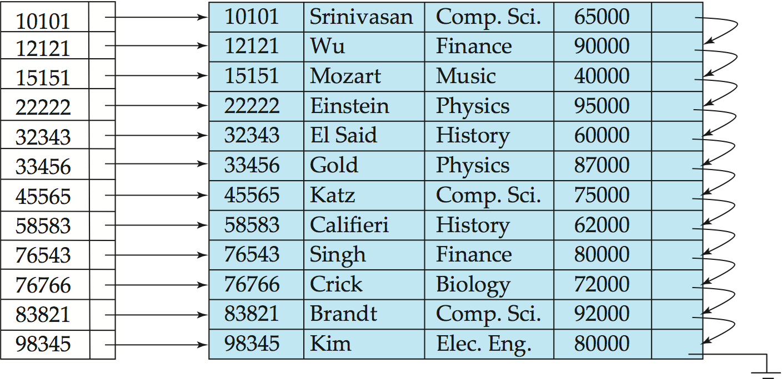
Dense Index Files
Dense index — Index record appears for every search-key value in the file.
E.g. index on ID attribute of instructor relation

Slide 6
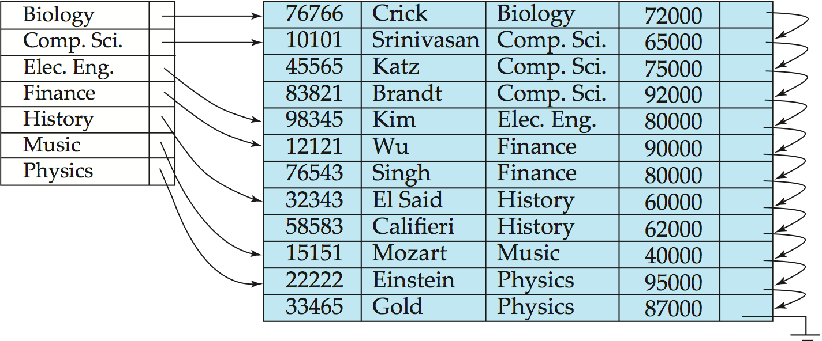
Dense Index Files (Cont.)
Dense index on dept_name, with instructor file sorted on dept_name

Slide 7
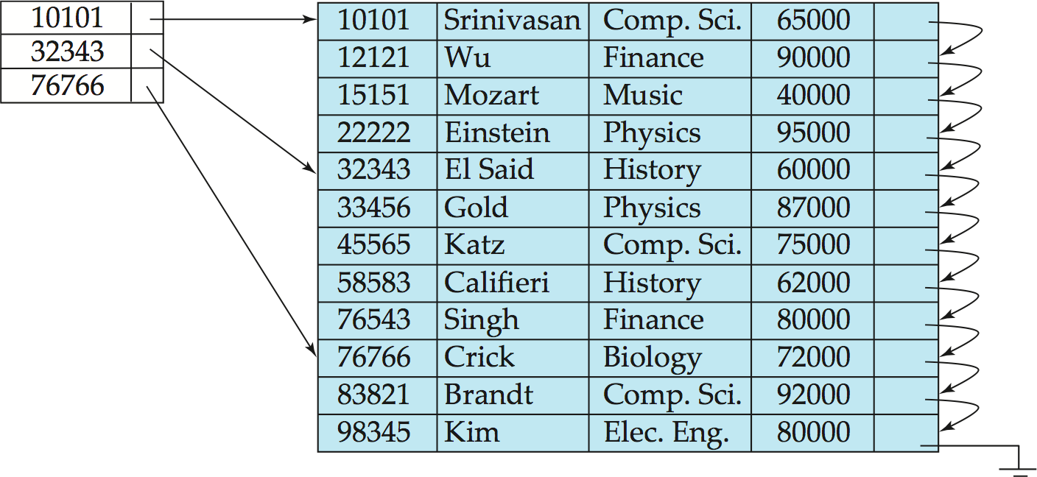
Sparse Index Files
Sparse Index: contains index records for only some search-key values.
Applicable when records are sequentially ordered on search-key
To locate a record with search-key value K we:
Find index record with largest search-key value < K
Search file sequentially starting at the record to which the index record points

Slide 8
Sparse Index Files (Cont.)
Compared to dense indices:
Less space and less maintenance overhead for insertions and deletions.
Generally slower than dense index for locating records.
Good tradeoff: sparse index with an index entry for every block in file, corresponding to least search-key value in the block.

Slide 9
Secondary Indices Example
Secondary index on salary field of instructor
Index record points to a bucket that contains pointers to all the actual records with that particular search-key value.
Secondary indices have to be dense
Notes:
9

Slide 10
Multilevel Index
If primary index does not fit in memory, access becomes expensive.
Solution: treat primary index kept on disk as a sequential file and construct a sparse index on it.
outer index – a sparse index of primary index
inner index – the primary index file
If even outer index is too large to fit in main memory, yet another level of index can be created, and so on.
Indices at all levels must be updated on insertion or deletion from the file.

Slide 11
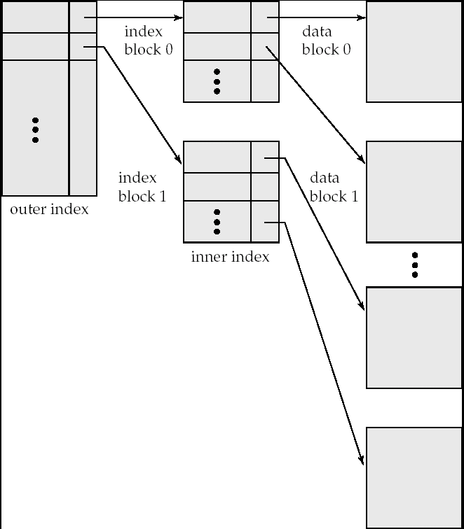
Multilevel Index (Cont.)

Slide 12
B⁺-Tree Index Files
B⁺-tree indices are an alternative to indexed-sequential files.
Disadvantage of indexed-sequential files
performance degrades as file grows, since many overflow blocks get created.
Periodic reorganization of entire file is required.
Advantage of B⁺-tree index files:
automatically reorganizes itself with small, local, changes, in the face of insertions and deletions.
Reorganization of entire file is not required to maintain performance.
(Minor) disadvantage of B⁺-trees:
extra insertion and deletion overhead, space overhead.
Advantages of B⁺-trees outweigh disadvantages
B⁺-trees are used extensively

Slide 13
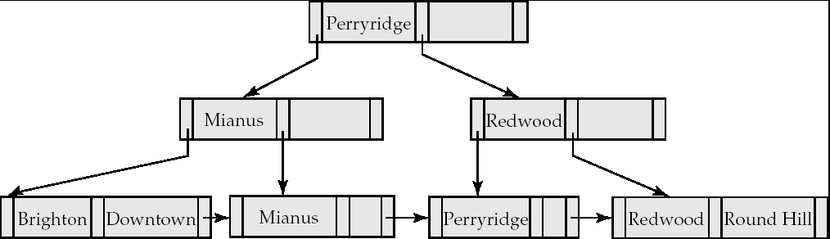
B⁺-Tree Index Files (Cont.)
A B⁺-tree is a rooted tree satisfying the following properties:
All paths from root to leaf are of the same length
Each node that is not a root or a leaf has between ⎡n/2⎤ and n children.
A leaf node has between ⎡(n–1)/2⎤ and n–1 values
Special cases:
If the root is not a leaf, it has at least 2 children.
If the root is a leaf (that is, there are no other nodes in the tree), it can have between 0 and (n–1) values.

Slide 14
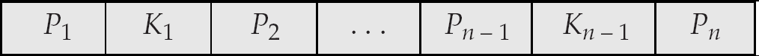
B⁺-Tree Node Structure
Typical node
K_{i} are the search-key values
P_{i} are pointers to children (for non-leaf nodes) or pointers to records or buckets of records (for leaf nodes).
The search-keys in a node are ordered
K₁ < K₂ < K₃ < . . . < K_{n–1}

Slide 15
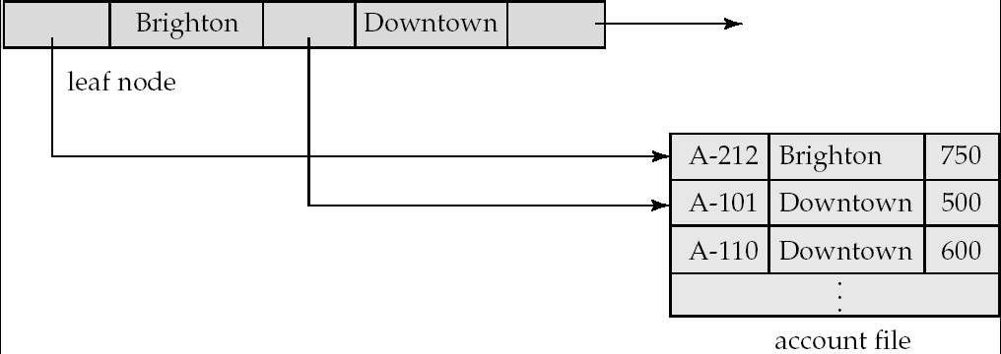
Leaf Nodes in B⁺-Trees
Properties of a leaf node:
For i = 1, 2, . . ., n–1, pointer P_{i} either points to a file record with search-key value K_{i}, or to a bucket of pointers to file records, each record having search-key value K_{i}. Only need bucket structure if search-key does not form a primary key.
If L_{i}, L_{j} are leaf nodes and i < j, L_{i}’s search-key values are less than L_{j}’s search-key values
P_{n} points to next leaf node in search-key order

Slide 16
Non-Leaf Nodes in B⁺-Trees
Non leaf nodes form a multi-level sparse index on the leaf nodes. For a non-leaf node with m pointers:
All the search-keys in the subtree to which P₁ points are less than K₁
For 2 ≤ i ≤ n – 1, all the search-keys in the subtree to which P_{i} points have values greater than or equal to K_{i–1} and less than K_{i}
All the search-keys in the subtree to which P_{n} points have values greater than or equal to K_{n–1}

Slide 17

Example of a B⁺-tree
B⁺-tree for account file (n = 3)

Slide 18
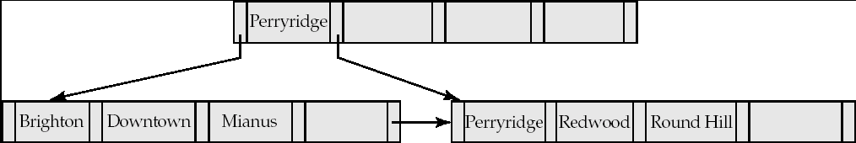
Example of B⁺-tree
B⁺-tree for account file (n = 5)
Leaf nodes must have between 2 and 4 values (⎡(n–1)/2⎤ and n –1, with n = 5).
Non-leaf nodes other than root must have between 3 and 5 children (⎡(n/2⎤ and n with n =5).
Root must have at least 2 children.

Slide 19
Construct a B+-tree for the following set of key values:2, 3, 5, 7, 11, 17, 19, 23, 29, 31Assume that the tree is initially empty and values are added in ascending order. Construct B+-trees for the cases where the number of pointers that will fit in one node is as follows: a. Four b. Six c. Eight

Slide 20
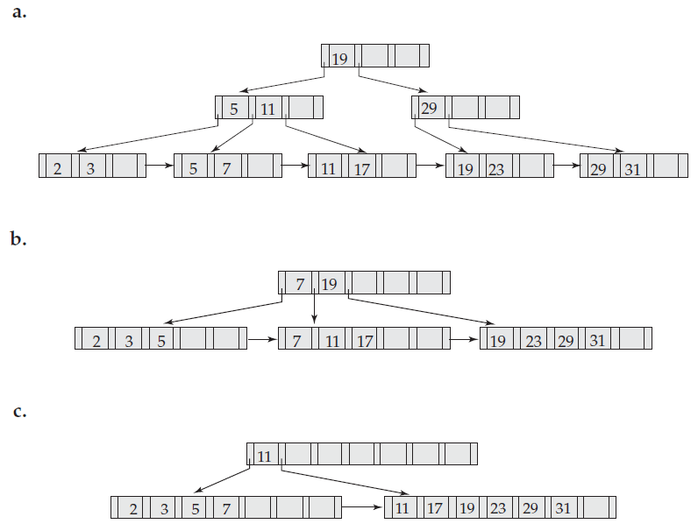

Slide 21
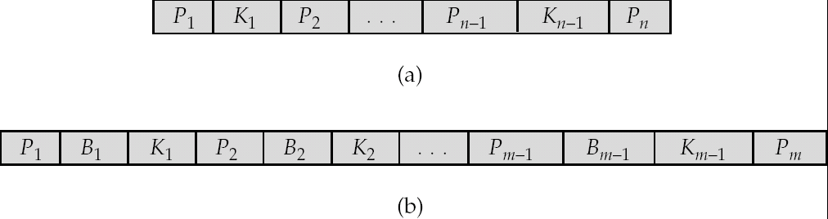
B-Tree Index Files
Similar to B+-tree, but B-tree allows search-key values to appear only once; eliminates redundant storage of search keys.
Search keys in nonleaf nodes appear nowhere else in the B-tree; an additional pointer field for each search key in a nonleaf node must be included.
Generalized B-tree leaf node
Nonleaf node – pointers Bi are the bucket or file record pointers.

Slide 22
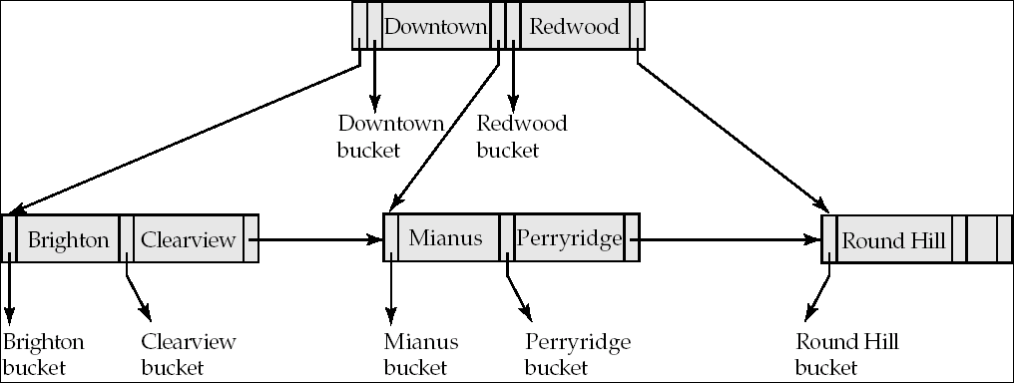
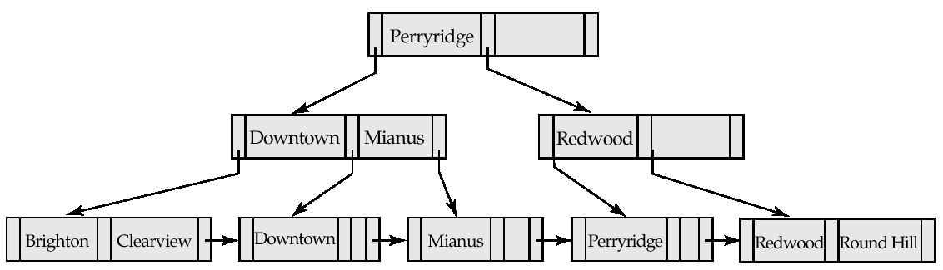
B-Tree Index File Example
B-tree (above) and B+-tree (below) on same data

Slide 23
B-Tree Index Files (Cont.)
Advantages of B-Tree indices:
May use less tree nodes than a corresponding B⁺-Tree.
Sometimes possible to find search-key value before reaching leaf node.
Disadvantages of B-Tree indices:
Only small fraction of all search-key values are found early
Insertion and deletion more complicated than in B⁺-Trees
Implementation is harder than B⁺-Trees.
Typically, advantages of B-Trees do not out weigh disadvantages.

Slide 24
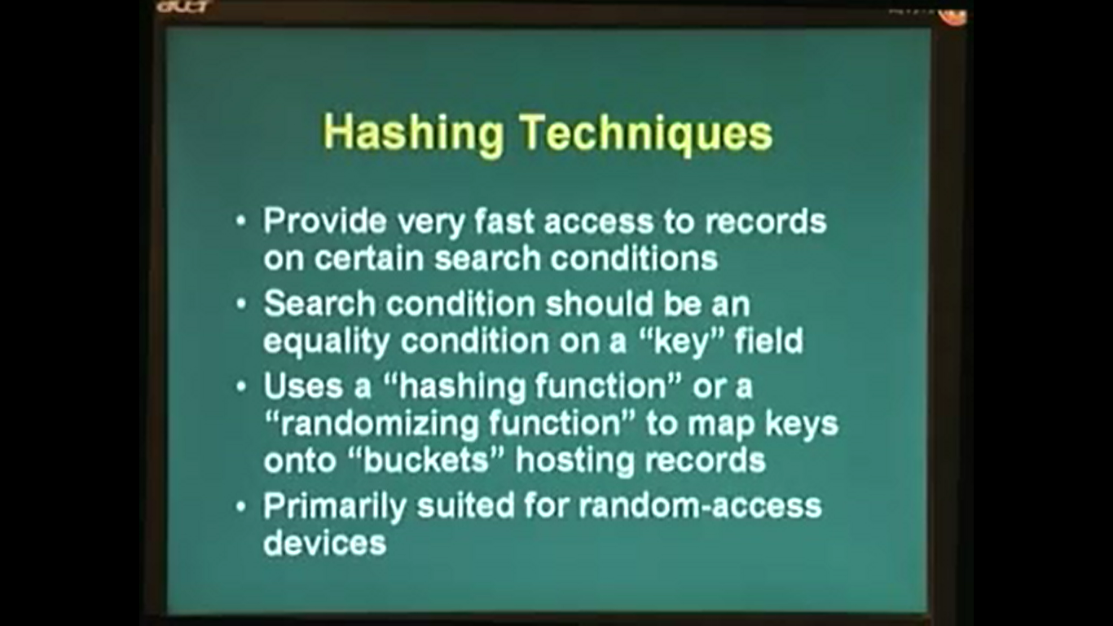

Slide 25
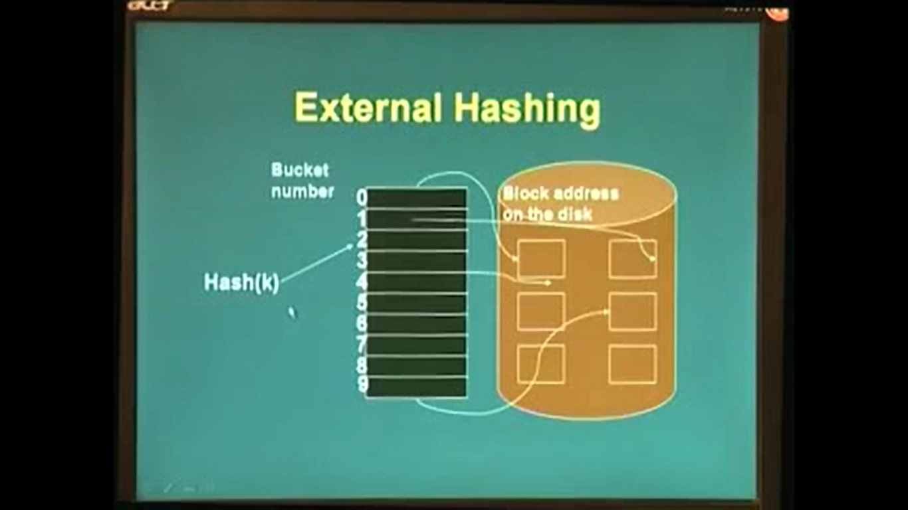

Slide 26
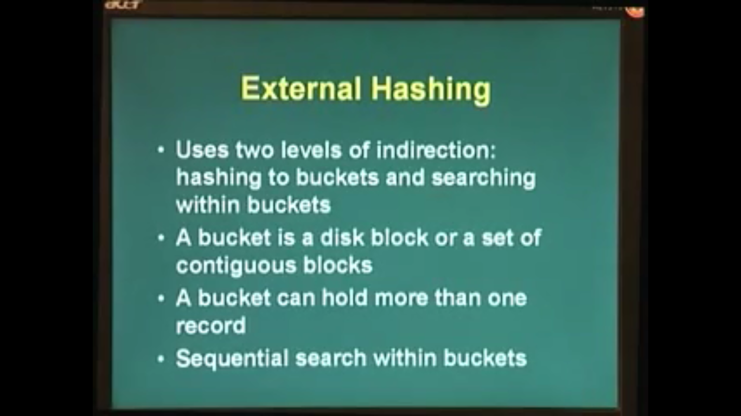

Slide 27
Static Hashing
A bucket is a unit of storage containing one or more records (a bucket is typically a disk block).
In a hash file organization we obtain the bucket of a record directly from its search-key value using a hash function.
Hash function h is a function from the set of all search-key values K to the set of all bucket addresses B.
Hash function is used to locate records for access, insertion as well as deletion.
Records with different search-key values may be mapped to the same bucket; thus entire bucket has to be searched sequentially to locate a record.

Slide 28
Example of Hash File Organization
Hash file organization of account file, using branch_name as key (See figure in next slide.)
There are 10 buckets,
The binary representation of the ith character is assumed to be the integer i.
The hash function returns the sum of the binary representations of the characters modulo 10
E.g. h(Perryridge) = 5 h(Round Hill) = 3 h(Brighton) = 3

Slide 29
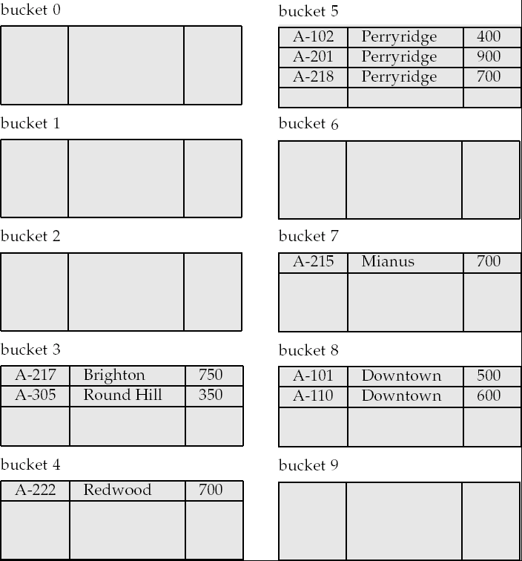
Example of Hash File Organization
Hash file organization of account file, using branch_name as key (see previous slide for details).

Slide 30
Hash Functions
Worst hash function maps all search-key values to the same bucket; this makes access time proportional to the number of search-key values in the file.
An ideal hash function is uniform, i.e., each bucket is assigned the same number of search-key values from the set of all possible values.
Ideal hash function is random, so each bucket will have the same number of records assigned to it irrespective of the actual distribution of search-key values in the file.
Typical hash functions perform computation on the internal binary representation of the search-key.
For example, for a string search-key, the binary representations of all the characters in the string could be added and the sum modulo the number of buckets could be returned. .

Slide 31
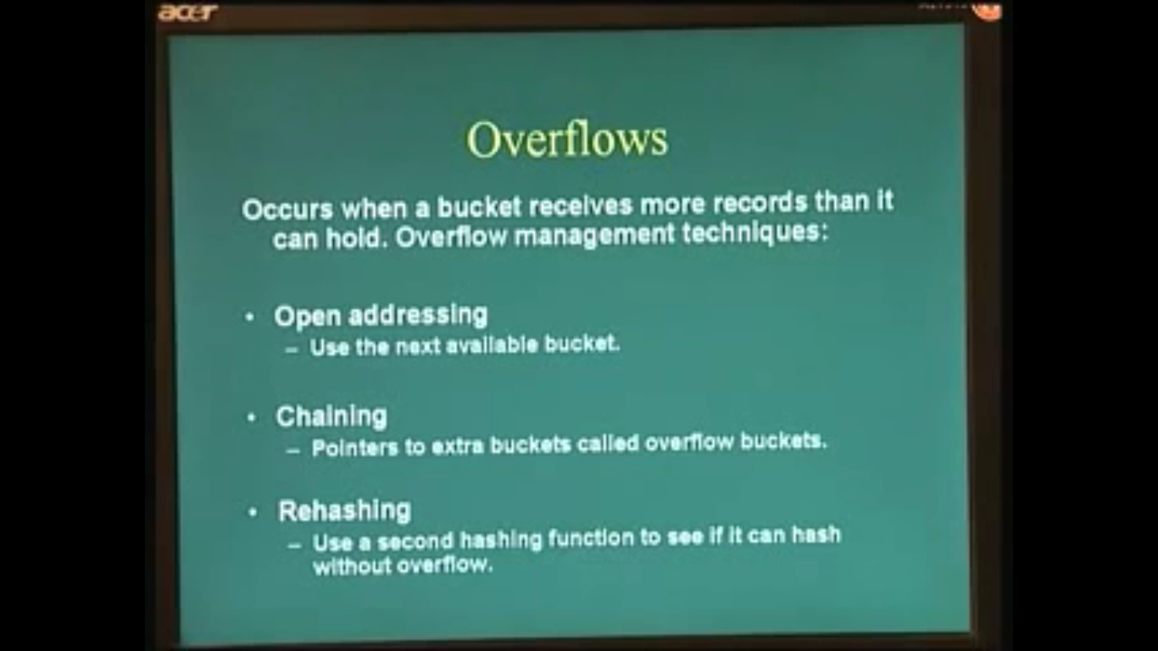

Slide 32
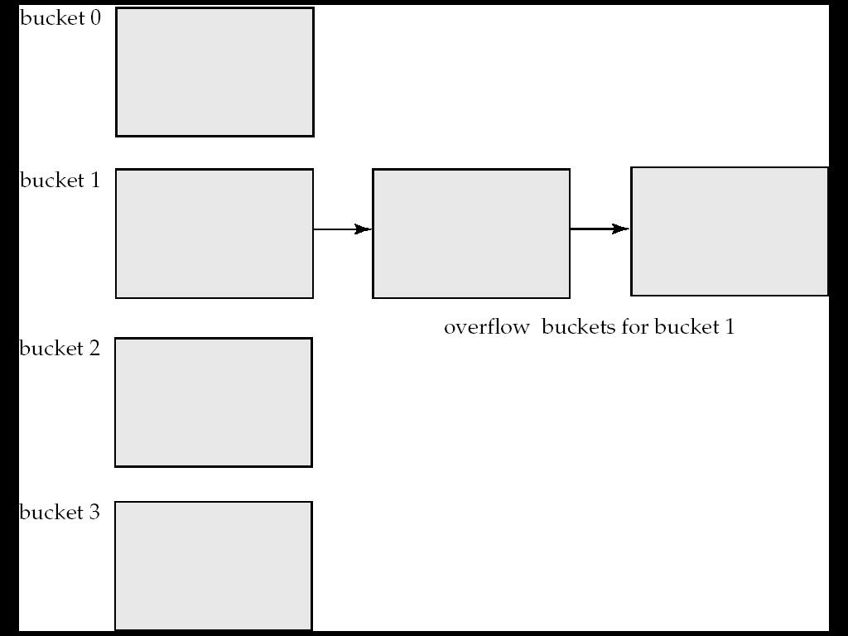
Handling of Bucket Overflows (Cont.)
Overflow chaining – the overflow buckets of a given bucket are chained together in a linked list.
Above scheme is called closed hashing.
An alternative, called open hashing, which does not use overflow buckets, is not suitable for database applications.

Slide 33
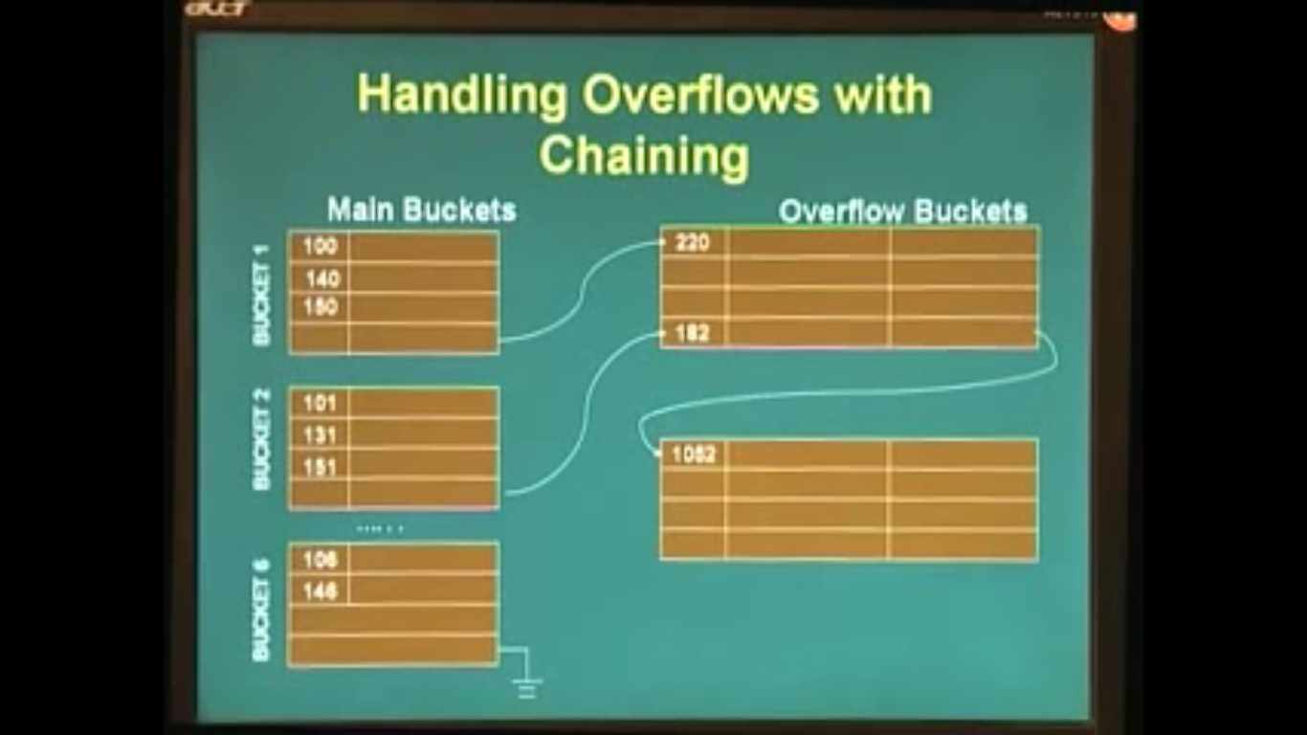

Slide 34
Deficiencies of Static Hashing
In static hashing, function h maps search-key values to a fixed set of B of bucket addresses. Databases grow or shrink with time.
If initial number of buckets is too small, and file grows, performance will degrade due to too much overflows.
If space is allocated for anticipated growth, a significant amount of space will be wasted initially (and buckets will be underfull).
If database shrinks, again space will be wasted.
One solution: periodic re-organization of the file with a new hash function
Expensive, disrupts normal operations
Better solution: allow the number of buckets to be modified dynamically.

Slide 35
Index Definition in SQL
Create an index
create index <index-name> on <relation-name> (<attribute-list>)
E.g.: create index b-index on branch(branch_name)
Use create unique index to indirectly specify and enforce the condition that the search key is a candidate key is a candidate key.
Not really required if SQL unique integrity constraint is supported
To drop an index
drop index <index-name>
Most database systems allow specification of type of index, and clustering.

Slide 36
Thank you
Nilesh.shelke@sitnagpur.siu.edu.in
M- 9890383745

